Slide 1
Accelerating (Geo)Spatial Analytics
Luis Felipe Romero
Rafael Asenjo

Slide 2
QGIS in Depth
The QGIS calculator
Vector operations
Raster operations
Overview of the QGIS console
Automatizing rendering and processing task
Working with raster and vector layers in console
Vector layer → The COVID map
Raster Layer → Floods in Malaga
Vector + Raster → Flight viewshed
Command line use pyQGIS & GDAL

Slide 3
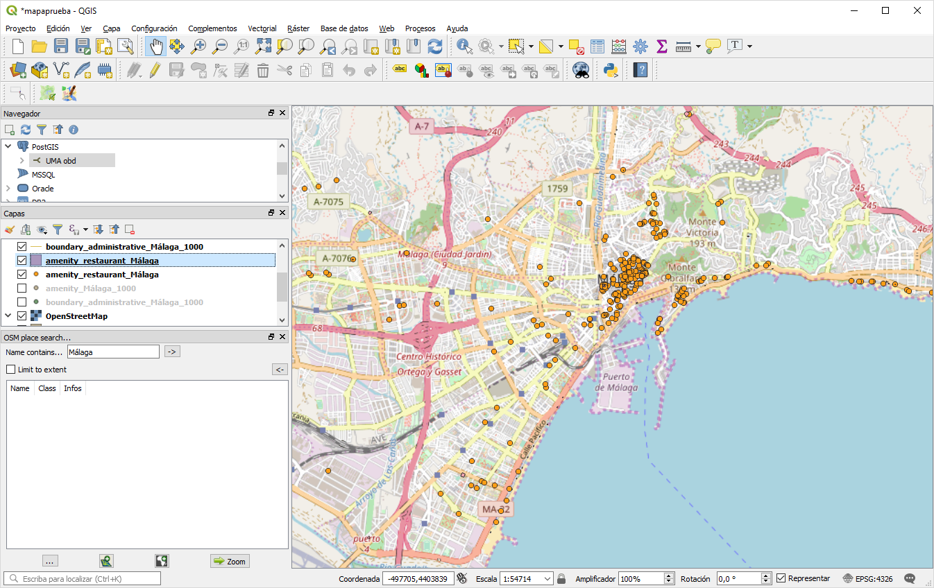
QGIS Review
Menu bar
Tools bar
Navigation
Layers
Map view (Lienzo)
A frequent place for
additional panels
(view panels)
When opened, Python console goes here
Map view CRS

Slide 4
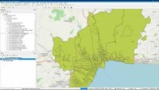
QGIS Calculator (vector)

Slide 5
QGIS Calculator (raster)
Insertar video o slides para crear una máscara dem
con el ejemplo del parque nacional Sierra de las Nieves

Slide 6
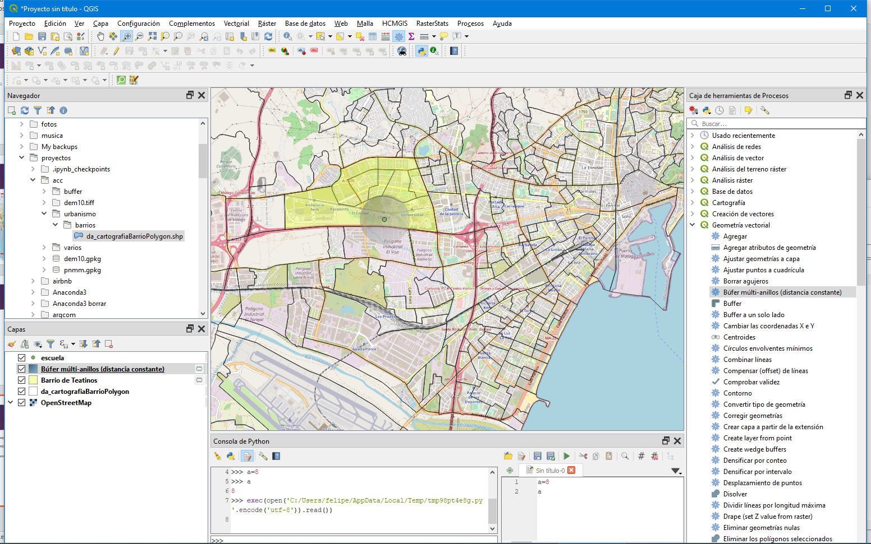
QGIS – Console
Python console
Editor

Slide 7
Anexes

Slide 8
Useful QGIS Layers
http://www.juntadeandalucia.es/medioambiente/mapwms/REDIAM_mde_andalucia
http://www.juntadeandalucia.es/medioambiente/mapwms/REDIAM_WCS_mdt
https://datosabiertos.malaga.eu/dataset
Plugins
OpenStreetMap and OSM place search
Openlayers
Rasterstats, Timemanager
PostGIS connections
E.g., OBD Logger

